Slide 1

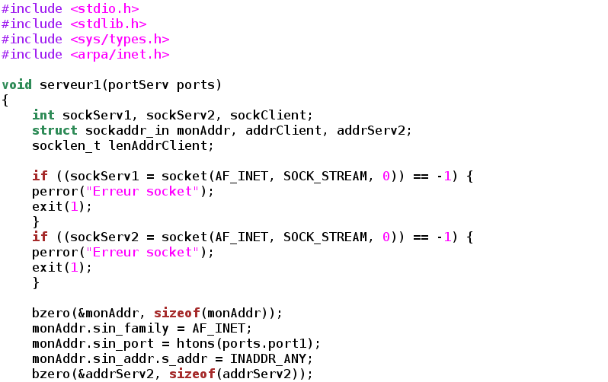


Introduction to C programming
Vistas in Advanced Computing Program
Martín Huarte-Espinosa
mhuartee@central.uh.edu
cacdsatuh
@UHCACDS
www.cacds.uh.edu

Slide 2
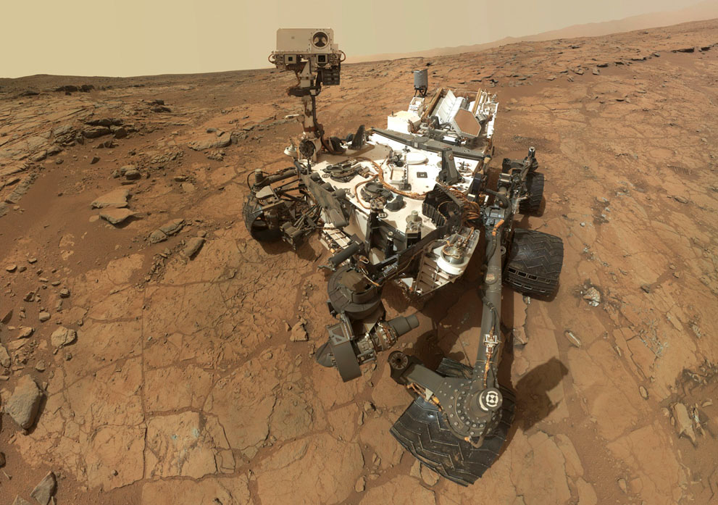
Why C?
500,000 lines of C code are powering NASA’s Mars Curiosity Rover
Notes:
Also used for kernel development

Slide 3
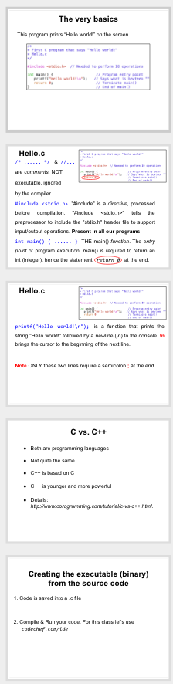
Overview
The main function and the very basics
Declaring variables & reading from keyboard
Arithmetics, Math and simple arrays
Loops, IFs and condition/logical operators
References.

Slide 4
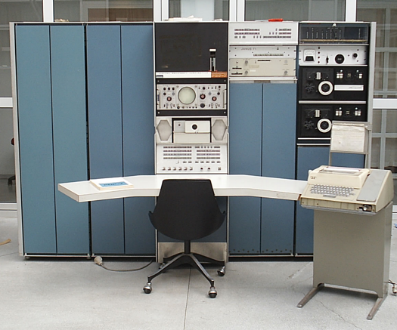
C - Historical highlights
C stems from the language BCPL, developed by Martin Richards. Indirect influence through the language B by Ken Thompson in 1970 at Bell Labs, for the first UNIX system on a DEC PDP-7 (photo).
In 1972 Dennis Ritchie at Bell Labs writes C and in 1978 the publication of The C Programming Language by Kernighan & Ritchie revolutionized the computing world.
wikipedia
Standardized by the American National Standards Institute since 1989 and subsequently by the International Organization for Standardization.
One of the most widely used programming languages
Various C compilers available for the majority of computer architectures and operating systems.
Many younger languages have borrowed directly or indirectly from C, including C++, Java, and Python.

Slide 5
C vs. C++
Both are programming languages
Not quite the same
C++ is based on C
C++ is younger and more powerful
Details: http://www.cprogramming.com/tutorial/c-vs-c++.html.

Slide 6
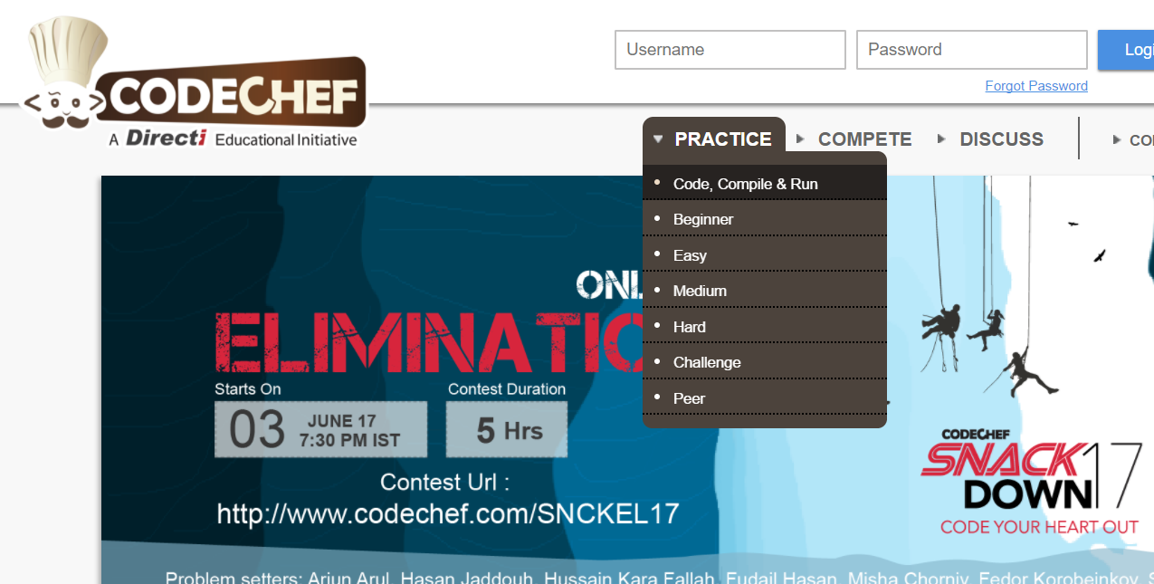
We use the website Codechef.com to write our code; compile and run them. Steps to open :
Go to https://www.codechef.com/ on your browser
Under “Practice” goto Code,Compile & Run

Slide 7
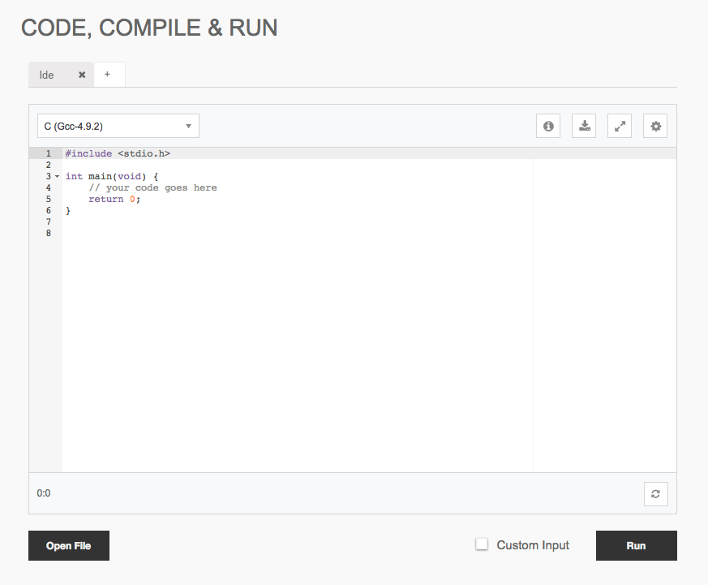
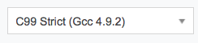
3.Change the programming language to C from the dropdown

Slide 8
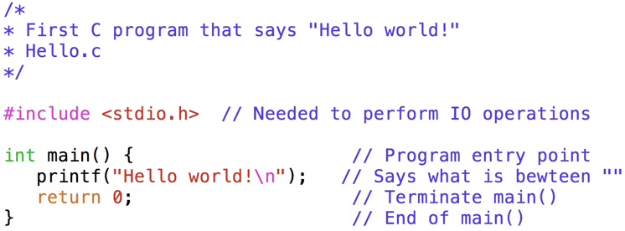
The very basics
Use a text editor to open the code file Hello.c.
This program prints “Hello world!” on the screen.

Slide 9
Hello.c
/* ...... */ & //...
are comments; NOT
executable, ignored
by the compiler.

Slide 10
Hello.c
/* ...... */ & //...
are comments; NOT
executable, ignored
by the compiler.
#include <stdio.h> "#include" is a directive, processed before compilation. "#include <stdio.h>" tells the preprocessor to include the "stdio.h" header file to support input/output operations. Present in all our programs.

Slide 11
Hello.c
/* ...... */ & //...
are comments; NOT
executable, ignored
by the compiler.
#include <stdio.h> "#include" is a directive, processed before compilation. "#include <stdio.h>" tells the preprocessor to include the "stdio.h" header file to support input/output operations. Present in all our programs.
int main() { ...... } THE main() function. The entry point of program execution. main() is required to return an int (integer), hence the statement return 0 at the end.

Slide 12
Hello.c
printf("Hello world!\n"); is a function that prints the string "Hello world!" followed by a newline (\n) to the console. \n brings the cursor to the beginning of the next line.

Slide 13
Hello.c
printf("Hello world!\n"); is a function that prints the string "Hello world!" followed by a newline (\n) to the console. \n brings the cursor to the beginning of the next line.
return 0; Terminates the main() function and returns a value of 0 to the operating system. NEEDED.

Slide 14
Hello.c
printf("Hello world!\n"); is a function that prints the string "Hello world!" followed by a newline (\n) to the console. \n brings the cursor to the beginning of the next line.
return 0; Terminates the main() function and returns a value of 0 to the operating system. NEEDED.
Note ONLY these two lines require a semicolon ; at the end.

Slide 15
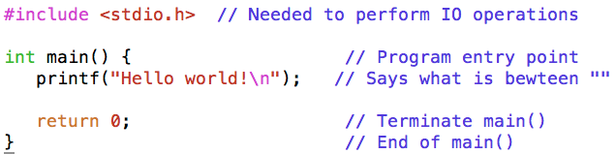
Let’s add a few more lines to Hello.c.
Add this below int main() {
int integer1;
Add these below printf...;
printf("Enter integer: ");
scanf("%d", &integer1);
printf("%d + 1 = %d \n", integer1, integer1+1);

Slide 16
int integer1;
printf("Enter integer: ");
1st part
scanf(“...” , ...);
2nd part
int used to DECLARE an integer number.
integer1 is the variable name or IDENTIFIER.
printf() prompts a message.
{
{

Slide 17
int integer1;
printf("Enter integer: ");
scanf("%d", &integer1);
scanf() reads user input from keyboard and stores into Integer1.
%d will be substituted by integer1.
int used to DECLARE an integer number.
integer1 is the variable name or IDENTIFIER.
printf() prompts a message.
An ampersand &, before integer1 stands for address-of operator.
A missing “&” in scanf() is a common error, leads to abnormal program termination.
“Segmentation fault (core dumped)”.

Slide 18
printf("%d + 1 = %d \n", integer1, integer1+1);
1st argument always between “”
each %d will be substituted by integers after the “,
Text ( + 1 = ) is printed as is
\n brings the cursor (jumps) to the next line.
2nd argument always after (“...”,
printf("%d + 1 = %d \n", integer1, integer1+1);

Slide 19
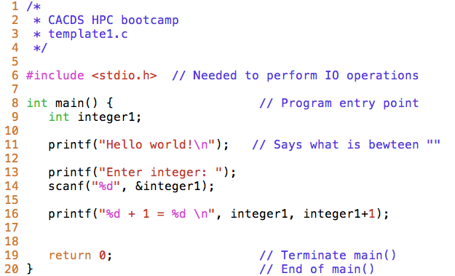
The program should look like this:
;
NOTE
All declaration and execution lines MUST end with ;

Slide 20
Exercise 1
The last program is saved in template2.c.
Add further lines to our program.
Add code so that:
- You keep the “Hello…” line but it’s not executed
- The program reads 2 integer numbers, instead of just one
- The program has an integer variable called sum which computes: integer1+integer2
- The program writes the integers and the sum result.
For example: If I enter 5 and 6, the program outputs:
“The sum of 5 and 6 is 11.”
Run.

Slide 21
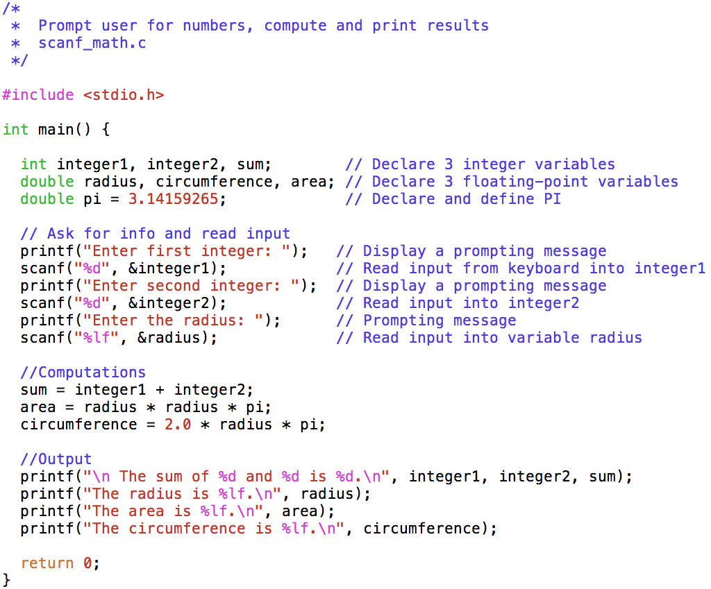
Let’s explore: read data from keyboard, do simple math, output results on screen.
Notes:
Removed (nano scanf_math.c). From the open scanf_math.c

Slide 22
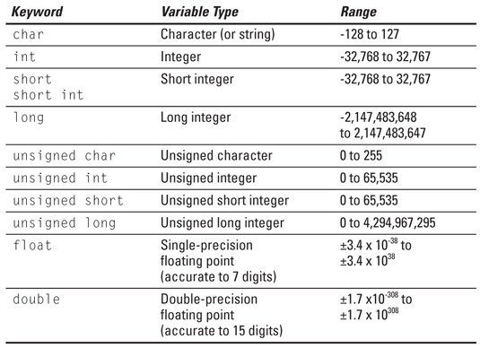
scanf_math.c

Slide 23
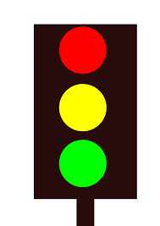
Variable names or identifiers
Allowed: 0, …, 9, a, …, z, A, …, Z, _
VARIABLE = variable; C is case sensitive.
No blanks or commas
First character cannot be a number
Reserved keywords (int, character, if, continue) not allowed
Name cannot be global identifier:
Valid: _NAME_ _SUM_
Invalid: _DATE_ _TIME_ _FILE_
Name cannot be the same as
another one within the scope of the
function:
Invalid:
/
#include<stdio.h> int main(){ int var1 = 1; int var1 = 2; printf("%d",var1); return 0; }

Slide 24
Back to scanf_math.c
scanf() reads keyboard input. Stores in radius.
A conversion specifier begins with %, followed by a data type code. %lf is for a double precision real number; stands for (l)ong (f)loat.
& before radius is for address-of operator. DON’T FORGET IT.

Slide 25
scanf_math.c
Basic arithmetics
<- VERY USEFUL
Operator | Meaning | Example
+ | Addition | x + y
- | Subtraction | x - y
* | Multiplication | x * y
/ | Division | x / y
% | Modulus (Remainder) | x % y
++ | Increment x by 1 | ++x or x++
-- | Decrement x by 1 | --x or x--

Slide 26
scanf_math.c
printf(“...”, ...);
1st argument always between “”. Consists of:
Text. Printed as is.
A conversion specifier begins with %, followed by a data type code. %d is for (d)ecimal integer.
\n brings the cursor (jumps) to the beginning of the next line.
2nd argument always after (“...”,.
first %d <- integer1
second %d <- integer2
third %d <- sum

Slide 27
scanf_math.c
printf();
%lf is for a double precision real number; stands for (l)ong (f)loat.
\n (again) brings the cursor to the beginning of next line.
2nd argument:
%lf <- radius

Slide 28
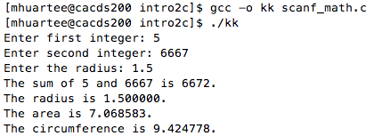
Let’s write this program into codechef. Then run.
Output:

Slide 29
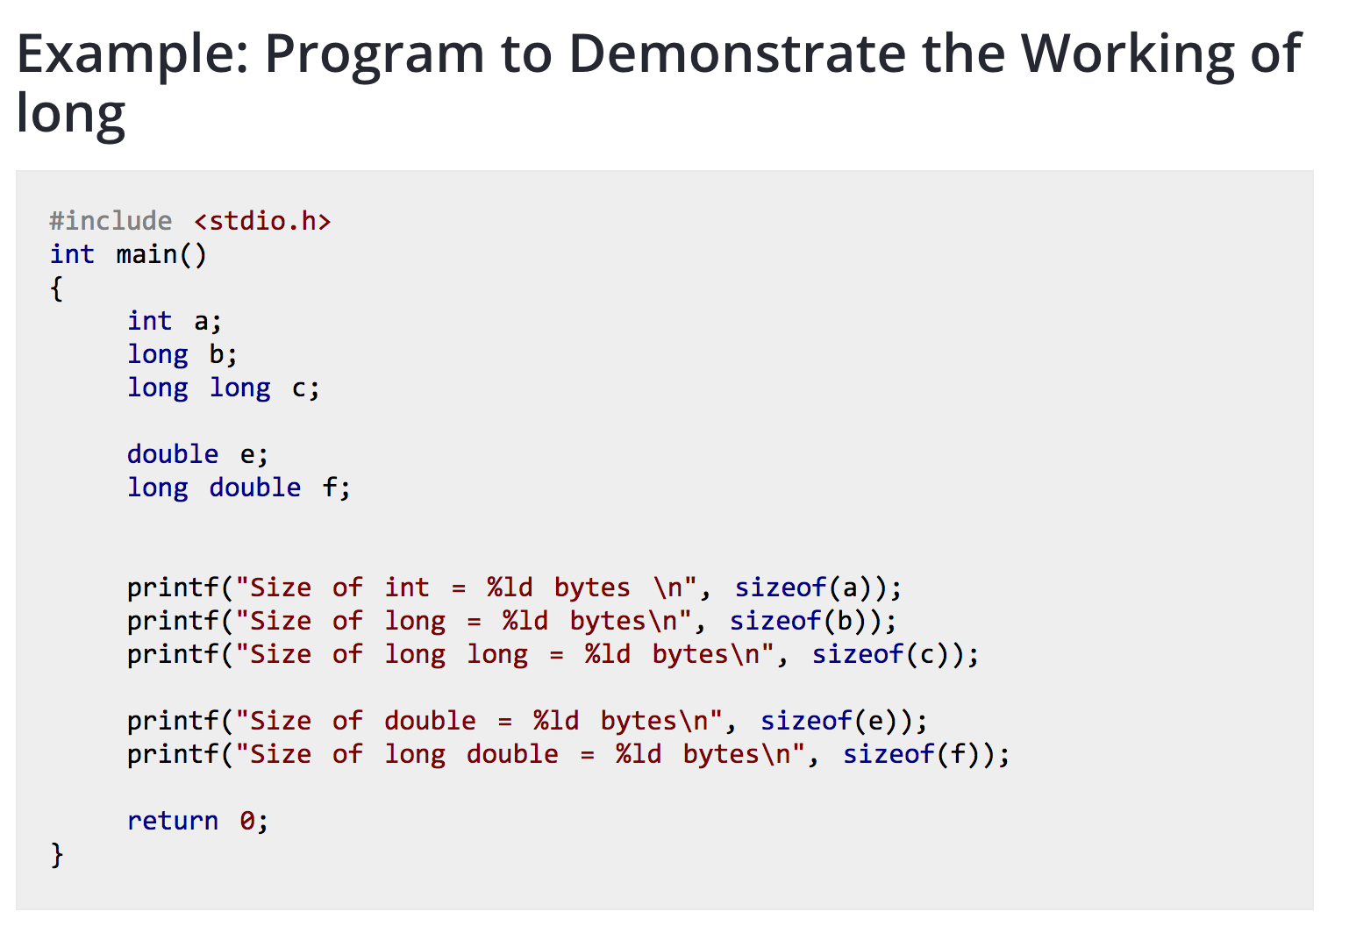
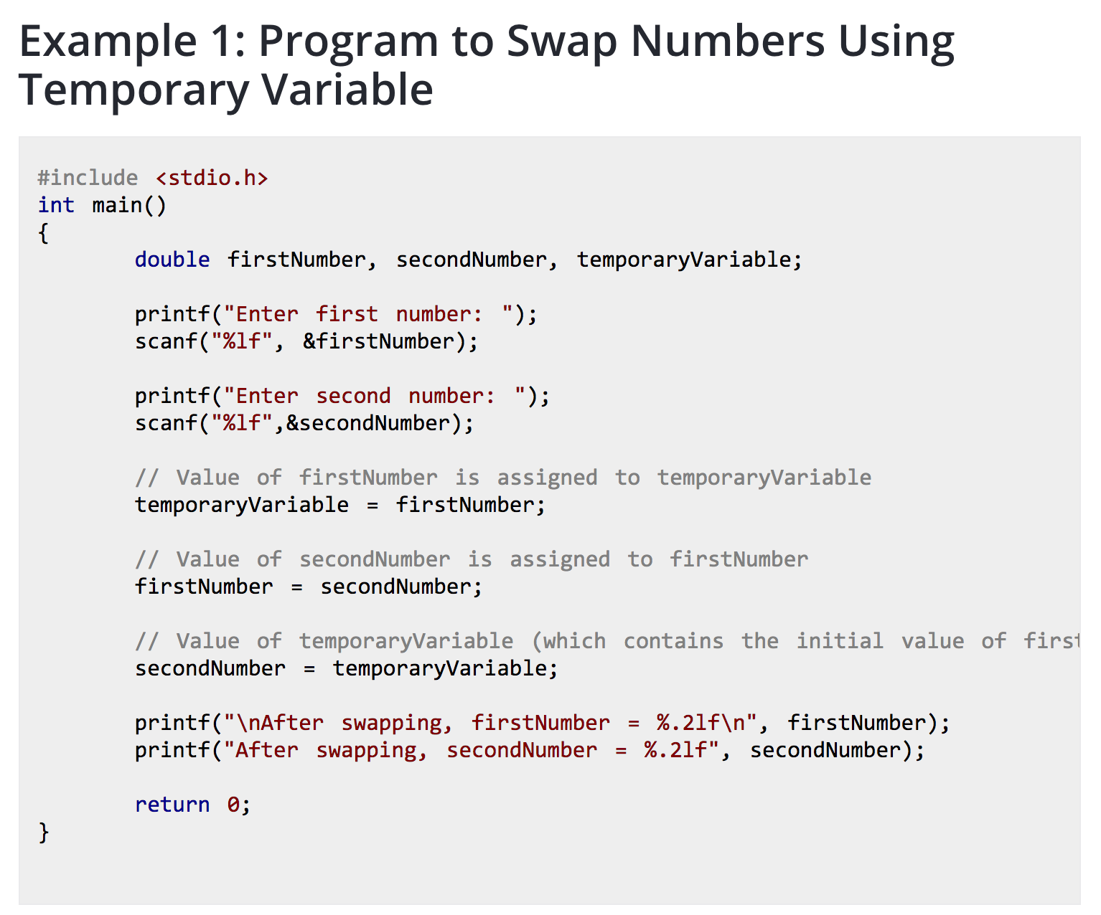
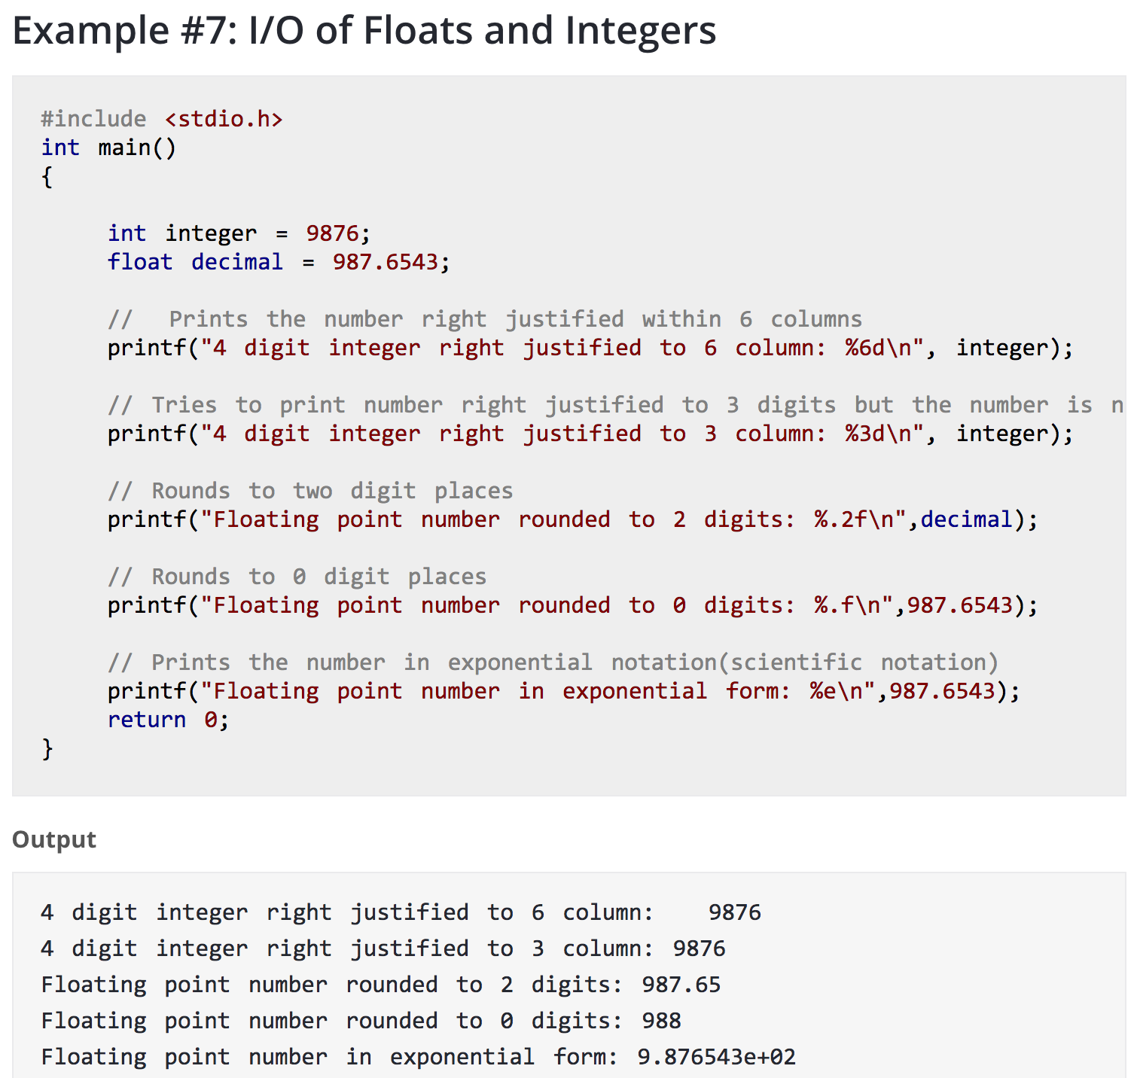
Afternoon VIDEOS
-c is awesome, https://youtu.be/smGalmxPVYc
-top 10 progr. Languages, https://youtu.be/MOz-fSDYlFc
-intro, hello world, https://youtu.be/CPjZKsUYSXg
Exercises
END OF DAY 1, 6/19/17

Slide 30
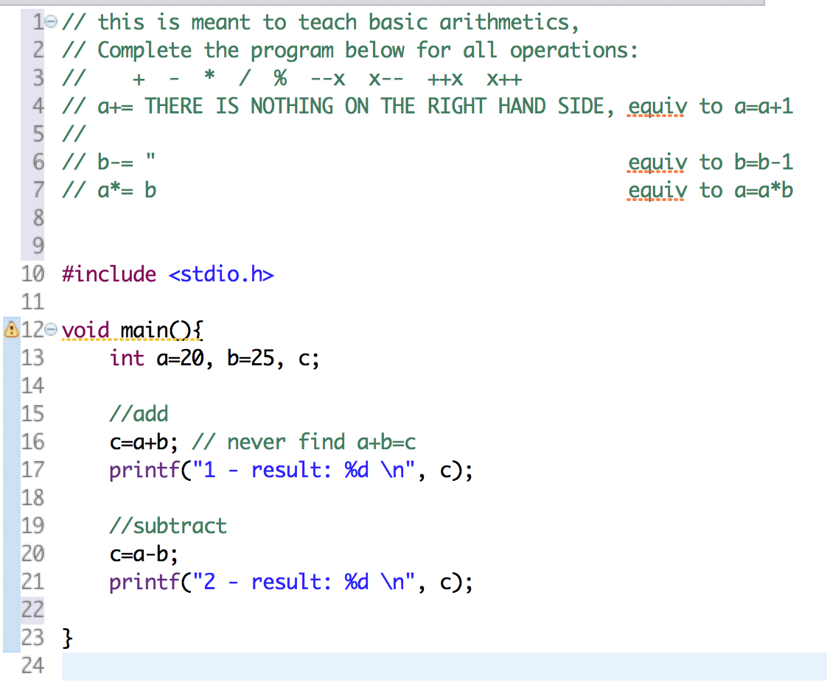
DAY 2 6/20/17
Morning Videos
Codeblocks set up, https://www.youtube.com/watch?v=3DeLiClDd04&index=2&list=PL6gx4Cwl9DGAKIXv8Yr6nhGJ9Vlcjyymq
Printf, scanf, https://youtu.be/xOIVXR35aI4
Operator | Meaning | Example
+ | Addition | x + y
- | Subtraction | x - y
* | Multiplication | x * y
/ | Division | x / y
% | Modulus (Remainder) | x % y
++ | Increment x by 1 | ++x or x++
-- | Decrement x by 1 | --x or x--

Slide 31
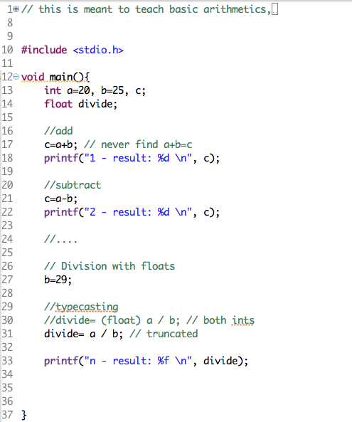
CTN. ...

Slide 32
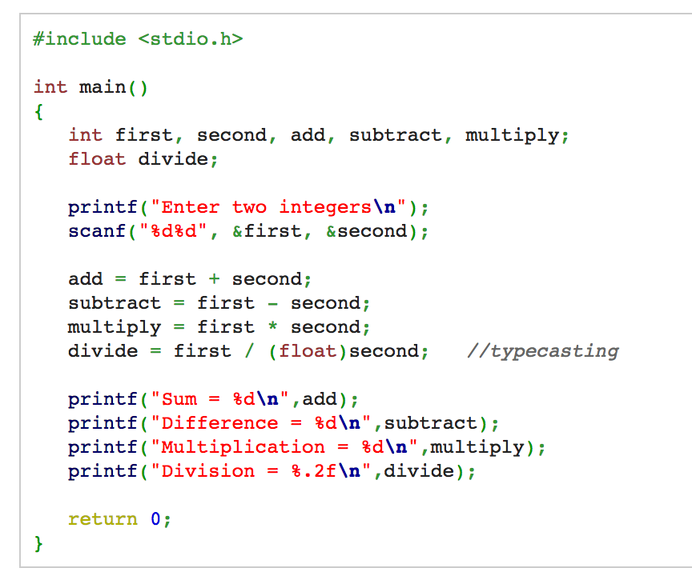
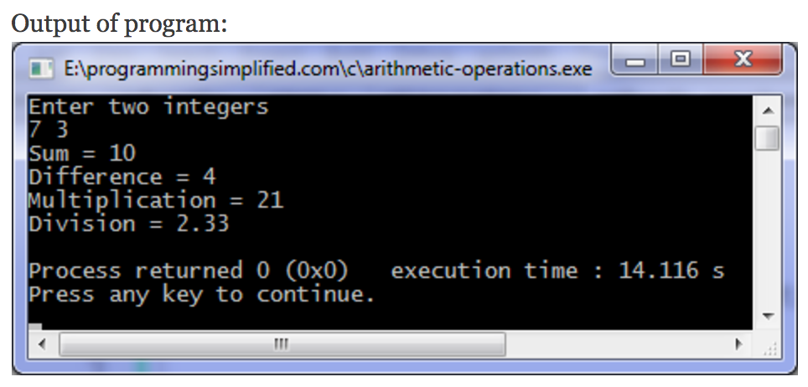

Slide 33
Math
Add #include <math.h> to the top of the program.
math.h is a header, defines various mathematical functions that take double as argument(s) and return double as a result. Some examples:
double cos(double x) Returns the cosine of x in rad.
double sin(double x) Returns the sine of x in rad.
double exp(double x) Returns the value of e raised to the xth power.
double log(double x) Returns the natural logarithm of x.
double pow(double x, double y) Returns x to the power of y.
double sqrt(double x) Returns the square root of x.
...

Slide 34
Math
Add #include <math.h> to the top of the program.
math.h is a header, defines various mathematical functions that take double as argument(s) and return double as a result. Some examples:
double cos(double x) Returns the cosine x in rad.
double sin(double x) Returns the sine x in rad.
double exp(double x) Returns the value of e raised to the xth power.
double log(double x) Returns the natural logarithm of x.
double pow(double x, double y) Returns x to the power of y.
double sqrt(double x) Returns the square root of x.
…
Note ^ is not the mathematical power operator in C (it's the bitwise exclusive-OR operator).

Slide 35
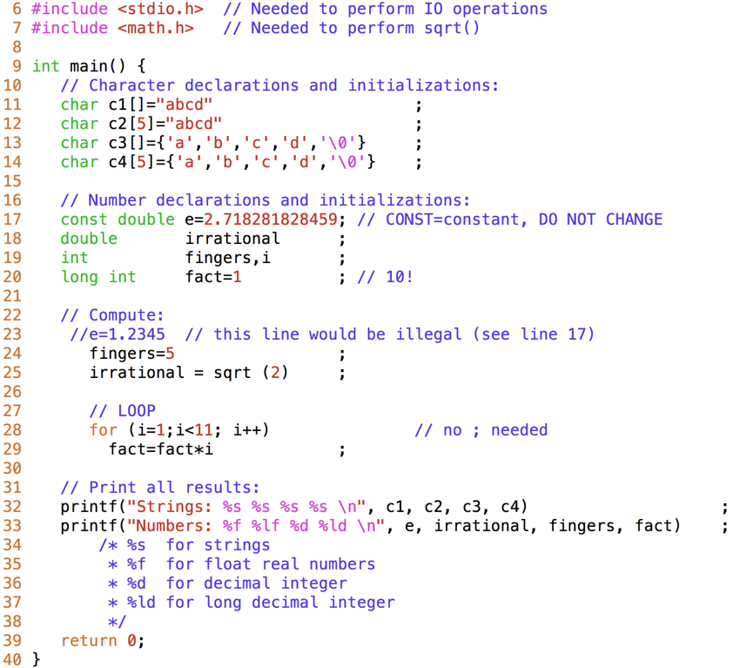
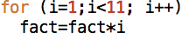
(template3.c)
Illustrates:
- Use of math.h, and sqrt() function (lines 7 & 25)
- Declare/initialize different data types (lines 11-25)
- How to print (or scan) different data types
(lines 32,33)
- The use of comments
- The use of white spaces for a friendly read
- A simple LOOP (more soon)

Slide 36
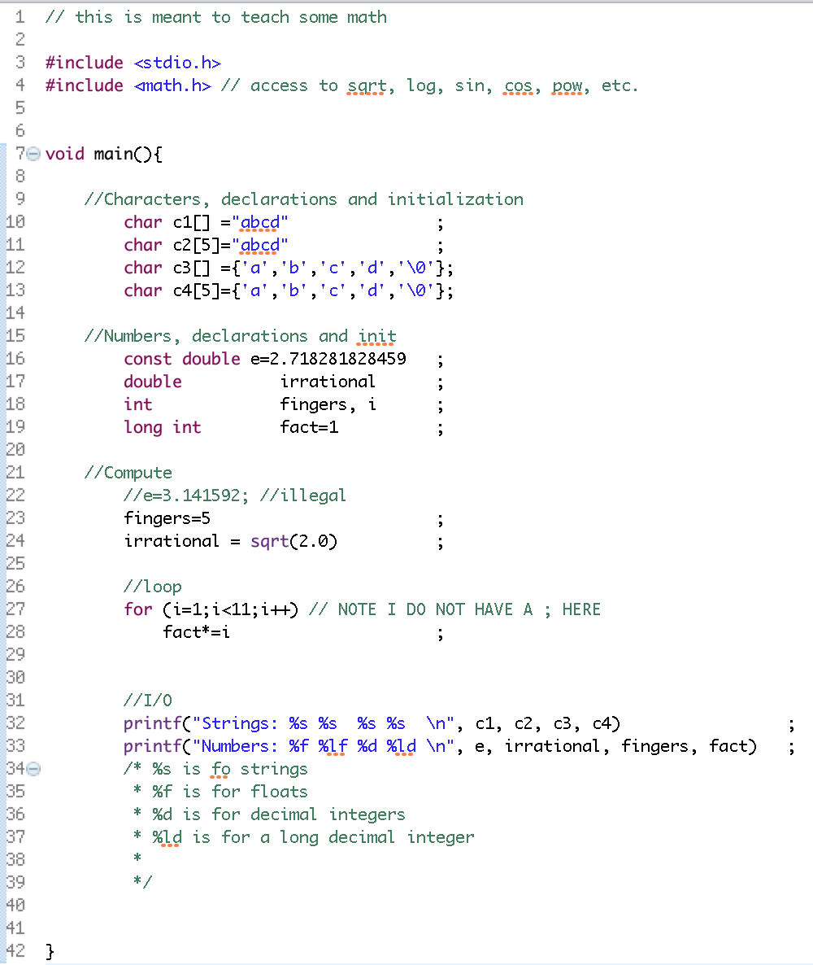
Template3.c as seeing in class

Slide 37
Exercise 2 -- read and interpret compiler messages
Run template3.c. Observe results and associate them with the code.
From (a) to (e) do:
1. Do the edit. Save the file and try to compile again. The compiler will output information.
2. Read the error messages and try to understand their logic.
3. Undo edit from step 1. Repeat steps 1-3 using the next edit in list.
(a) Comment line 7 (line 25 needs it)
(b) Remove ; from line 11 (needed).
(c) Add ; to the end of line 9 (not needed).
(d) Substitute i for j in line 28 (j not declared).
(e) Comment line 39 (needed).

Slide 38
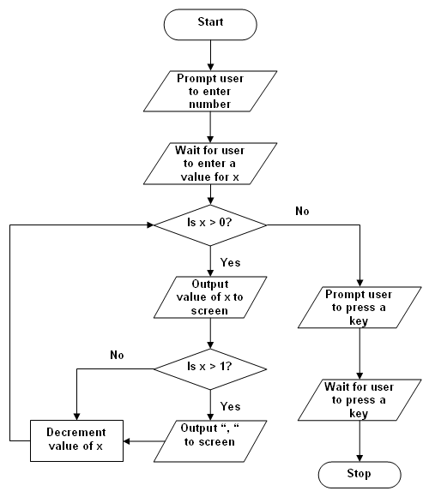
http://www.technologyuk.net/computing/c/control_structures.shtml
Control
Programs execute code line by line in increasing line order.
We say that “control” goes line
by line sequentially.
Control can be redirected using
“control statements”:
If-else
Loops (we saw one already)
Function calls

Slide 39
Control -- Loops
For recurrent statements. Useful for math, arrays and IO (which means in/out of data).
3 types: for loops, while loops and do loops.
For loop: for a specific number of iterations. 3 arguments.
for (variable initialization; condition; variable update ){
Statement1 to execute while condition is true;
Statement2 to execute while condition is true;
…
}
condition can be specified using
comparison operators:
Operator | Meaning | Example
== | Equal to | x == y
!= | Not equal to | x != y
> | Greater than | x > y
>= | Greater than or equal to | x >= y
< | Less than | x < y
<= | Less than or equal to | x <= y

Slide 40
Control -- Loops
For recurrent statements. Useful for math, arrays and IO (which means in/out of data).
3 types: for loops, while loops and do loops.
For loop: for a specific number of iterations. 3 arguments.
for (variable initialization; condition; variable update ){
Statement1 to execute while condition is true;
Statement2 to execute while condition is true;
…
}
Examples:
for (i=1; i<4; i++) for (i=2; i<11; i=i+2)
printf(“ %d ”, i ); printf(“ %d ”, i );
prints: 1 2 3 prints: 2 4 6 8 10
i=i+1

Slide 41
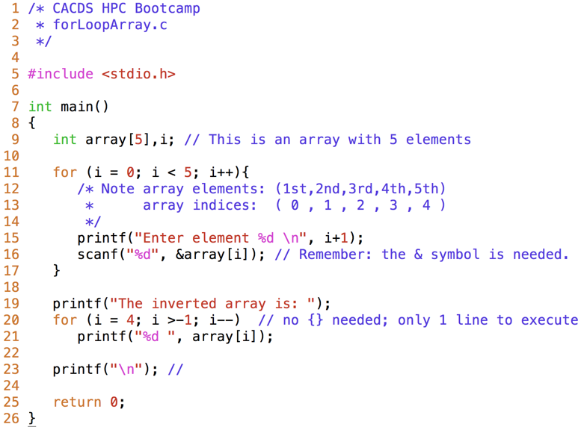
forLoopArray.c
Type and run.

Slide 42
Exercise 3 -- “for loops”
Edit forLoopArray2.c. It is a copy of forLoopArry.c for you to work on. Edit it so that:
It works with a 10 array element (instead of 5)
1st thing it asks is “How many elements (no more than 10)?”
Reads the answer from the keyboard
[REMEMBER scanf(“...”, &...);]
Then, after the section reading the element numbers (as before), it prints:
“Elements with even indices: “ followed by the actual numbers.
Example: Run.
“How many elements (no more than 10)?” 3
“Enter element 1” 1
“Enter element 2” 2
“Enter element 3” 3
“Elements with even indices: “ 2

Slide 43
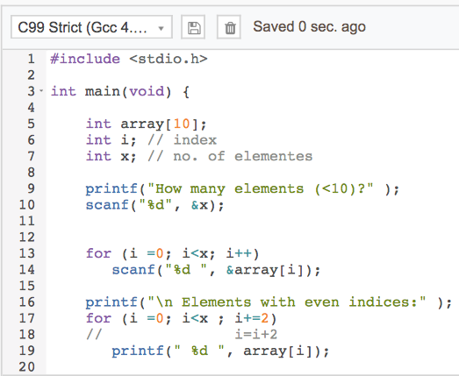
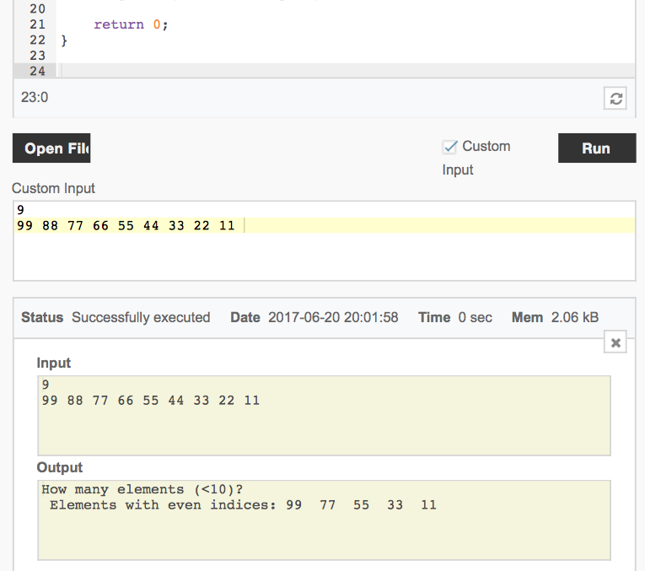

Slide 44
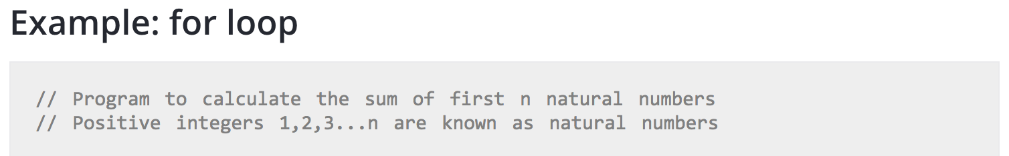

Slide 45
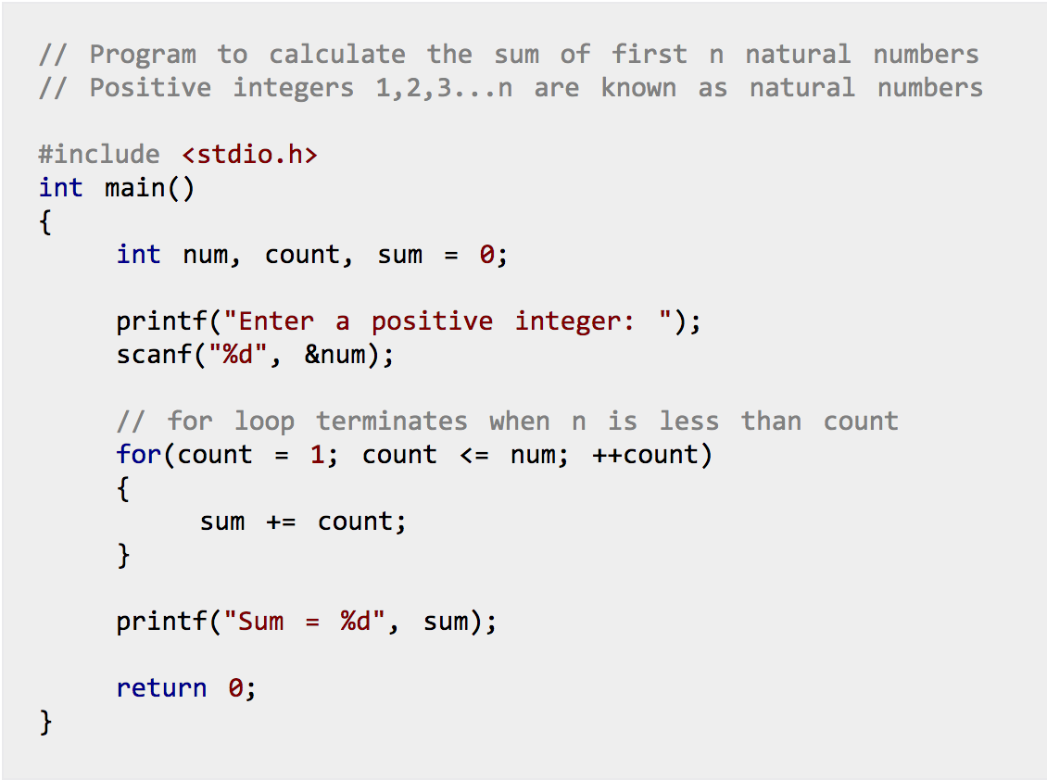

Slide 46
DAY3, 6/21/17
Morning videos
Increment opp https://youtu.be/nNSn1uVNyiU?list=PL6gx4Cwl9DGAKIXv8Yr6nhGJ9Vlcjyymq
Typecasting https://youtu.be/ohVRskLlHqM?list=PL6gx4Cwl9DGAKIXv8Yr6nhGJ9Vlcjyymq
Math functions
https://youtu.be/KQsSvedn94U
Then, do this test. DON’T CHEAT!!
http://www.sanfoundry.com/online-c-test-increment-decrement-operators/

Slide 47
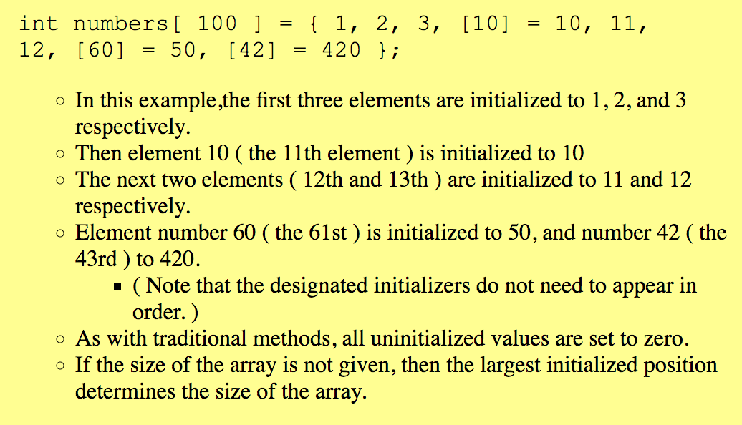
More on arrays.

Slide 48
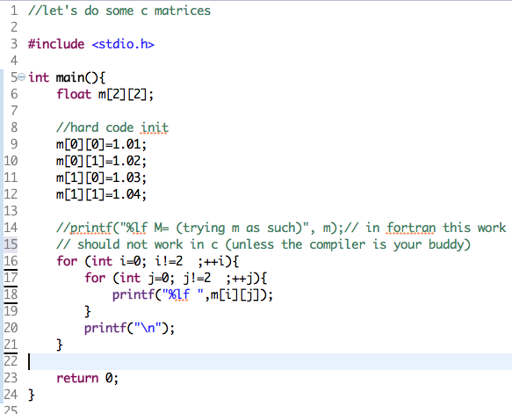

Slide 49
Do 4 programs:
Hard code a 3x3 matrix. Then transpose it… that means interchange rows by columns. Print both matrices at the end.
Do it for for a number N that you read from the keyboard. Reasonable N should go from 1 to 10, say. Also do it for data (matrix elements) that you read from keyboard.
Use for loops to print this on the screen:
A
AB
ABC
ABCD
ABCDE
Use for loops to print this on the screen: E)Pascal Triangle
A 1
BA 1 1
CBA 1 2 1
DCBA 1 3 3 1
EDCBA 1 4 6 4 1

Slide 50
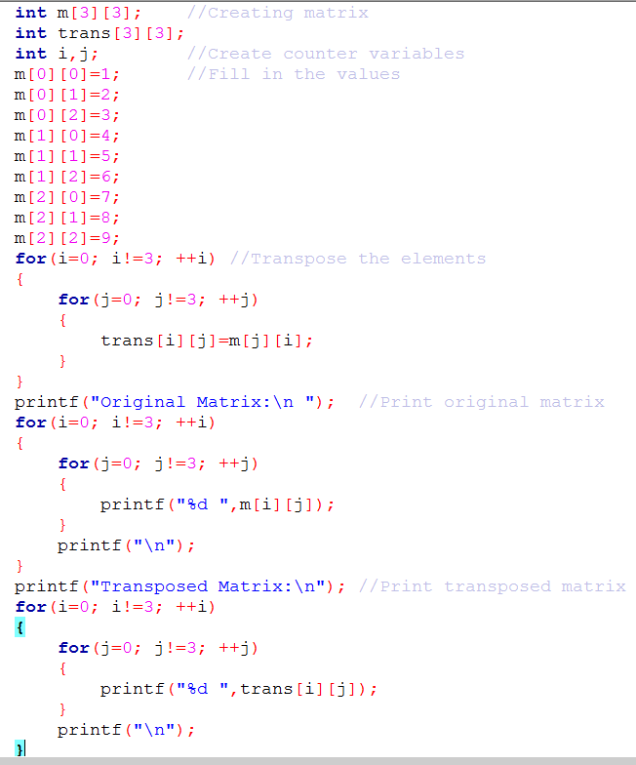
Problem A Solution:

Slide 51
Problem C Solution:
#include<stdio.h>
#include<math.h>
void main()
{
//initialize variable x to 'A'
char x='A';
int y;
int i,j;
int r;
printf("Enter a number of rows:");
scanf("%d",&r);
//first for loop controls the row and amount of characters that appear on the row
for(y=1;y!=(r+1);++y)
{
for(i=0;i!=y;++i)
{
printf("%c",x);
x++;
}
x='A';
printf("\n");
}
}

Slide 52
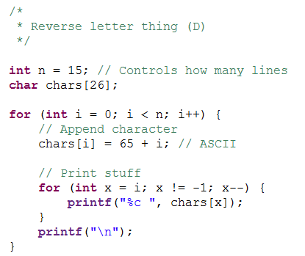
Problem D Solution:

Slide 53
Problem E (Pascal’s triangle) Solution:
int main()
{ int size =0;
printf("enter number of rows in triangle:");
scanf("%d",&size);//sets the size of array in a size X size area
size++;
int triangle[size][size];//initialization of array
for(int layer=0;layer<size;layer++)
{
for(int column=0;column<size;column++){
triangle[layer][column]= 0;
}
}
triangle[0][0]=1;
for(int layer=1;layer<size;layer++)//sets the numbers within the array to their respective number
{
triangle[layer][0]=1;
for(int column=1;column<layer;column++){
triangle[layer][column]= triangle[layer-1][column-1]+triangle[layer-1][column];
}
}
int count,temp,maxd=0;
for(int column=0;column<size;column++)//counts the number of digits in the last row
{

Slide 54
temp=triangle[size][column];
while(temp!=0) {
temp = temp/10;
++maxd;
}
}
for(int layer=0;layer<size;layer++)//this is the beginning of my print loop
{
for(int column=0;column<layer;column++)//counts the number of digits in each row
{
temp=triangle[layer][column];
while(temp!=0) {
temp = temp/10;
++count;
}
}
if(count<8)//these two make the first few lines of output pretty
count++;
if(count==1)
count++;
for(int x=0;x<(((maxd)-layer)-(count-layer)/2);x++)//adds appropriate number of spaces before the printing of integers
printf(" ");
for(int column=0;column<layer;column++){
printf("%d ",triangle[layer][column]);//prints number within [row][column] of the array
}
count =0;
printf("\n");
}
return 0;
}

Slide 55
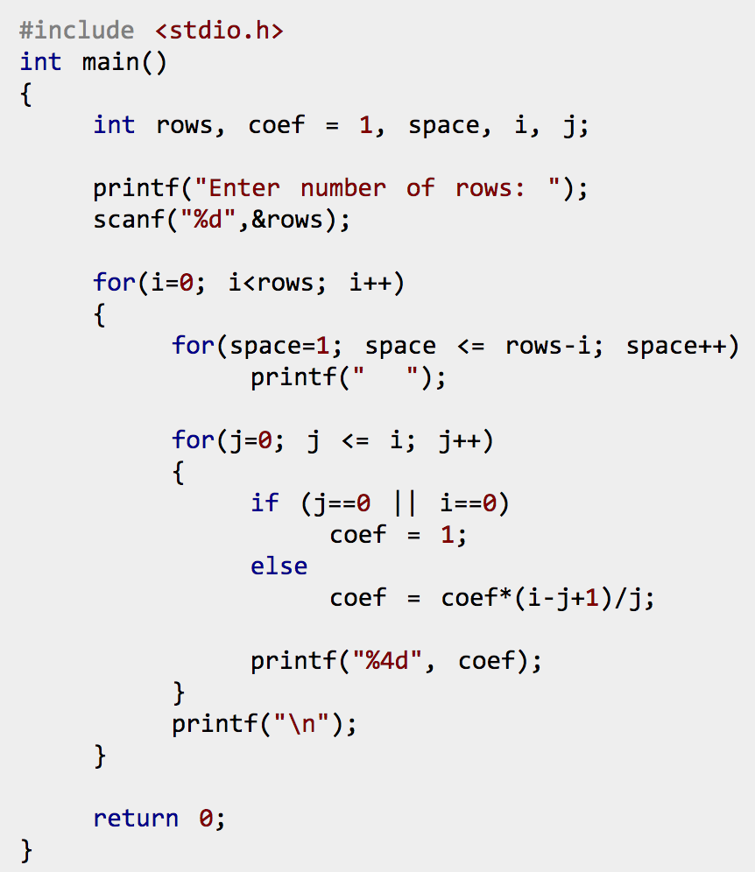
Official solution,
Pascal’s triangle.

Slide 56
While loops
Only one argument
while (condition){
Statement1 to execute while condition is true;
Statement2 to execute while condition is true;
…
Statement which may turn condition into false;
}

Slide 57
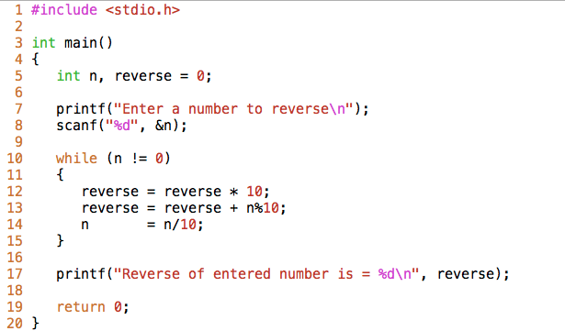
The modulus operator %
What does it do?

Slide 58
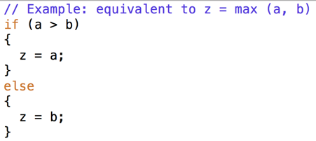
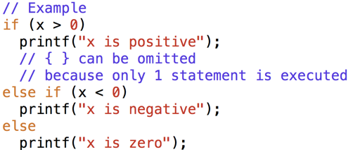
Control -- if
if (condition)
{ // executed only if condition is true
Statement(s);
}
else
{ // executed only if condition is false
Different statement(s);
}
if (condition1)
{ // executed if condition1 is true
Statement(s);
}
else if (condition2)
{ // executed if condition2 is true
Different statement(s);
}

Slide 59
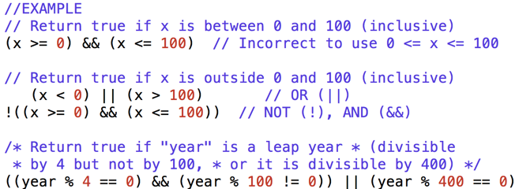
Control -- refine
Conditions leading the control can be refined using logical operators:
&& (and)
|| (or)
! (not)

Slide 60
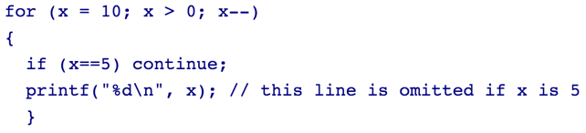
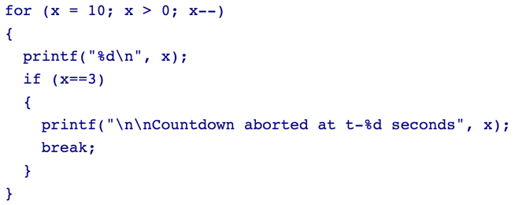
Control -- refine
Use if statements inside loops, along with
continue
break
Examples:

Slide 61
Exercise
Edit control.c (you will get it by email)
Replace ??? for the correct control statements so that the program computes the product of the input numbers.
Do you understand the purpose of all the lines?
If you do not, ask!.

Slide 62
Exercise -- Array operations
arrayOps.c into codechef (you will get it by email).
It illustrates how to do operations with arrays in C.
Add the appropriate code whenever you see “???”
Then run.
What do you see? Does it make sense?

Slide 63
“Homework”
Problems:
Find out what the header file string.h is. Then include it so you can use the function gets().
Use your finding to do a program reads words, and then writes them backwards.
Ex. read “martin” return “nitram”.
C) Use your findings to write a program that check whether two words are anagrams (words which have the same lattes and the same number of them).

Slide 64
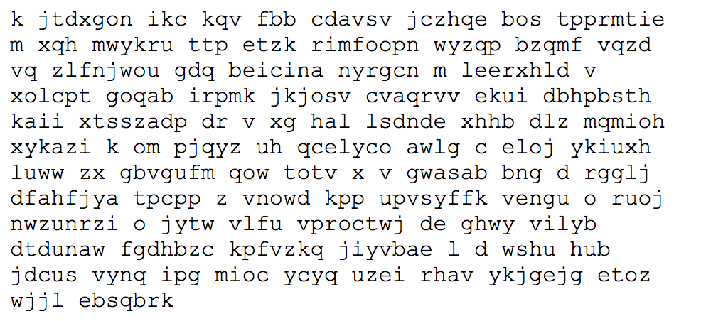
Have a look at this program
D) Write a program that generates and prints N random-sized words consisting of randomly selected characters. The word length should be 1 <= length <= max. Print no more than 50 characters per line. Typical output is:
#include <stdio.h> #include <stdlib.h> int main() { int r,a,b; puts("100 Random Numbers"); for(a=0;a<20;a++) { for(b=0;b<5;b++) { r=rand(); printf("%dt",r); } putchar('n'); } return(0); }

Slide 65
End of day 3
6/21/17

Slide 66
Day 4, 6/22/17
Morning videos
-array sorting, https://youtu.be/6qiNJWw5aLI
- matrices, https://youtu.be/qQra2GrjxJc
- if, https://youtu.be/DZ0ZXipUx-A?list=PL6gx4Cwl9DGAKIXv8Yr6nhGJ9Vlcjyymq
- while, https://youtu.be/7pAXm7WEA2I?list=PL6gx4Cwl9DGAKIXv8Yr6nhGJ9Vlcjyymq

Slide 67
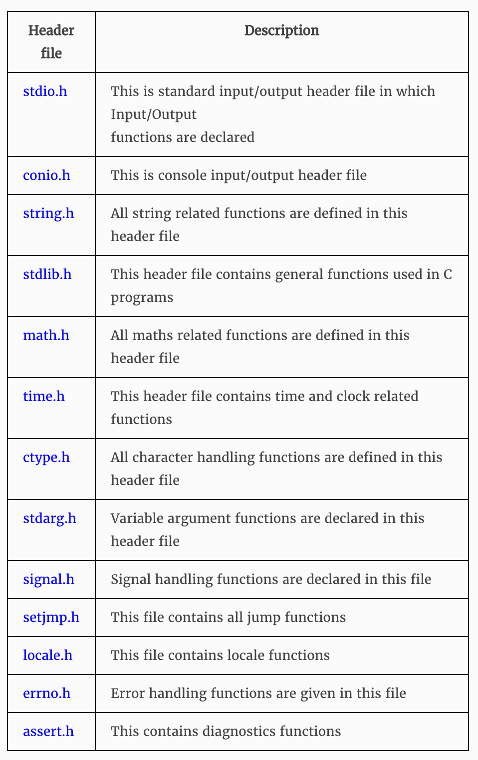
Library functions
Inbuilt functions which are grouped together and placed in a common place called library
Each library function in C performs specific operation
We can make use of these library functions to get the pre-defined output instead of writing our own code to get those outputs
Created by the persons who designed and created C compilers
Function declaration, definition for macros are given in all header files
We are including these header files in our C program using “#include<file_name.h>”
When we include header files in our C program using “#include<filename.h>” command, all C code of the header files are included in C program. Then, this C program is compiled by compiler and executed
http://fresh2refresh.com/c-programming/c-function/c-library-functions/

Slide 68
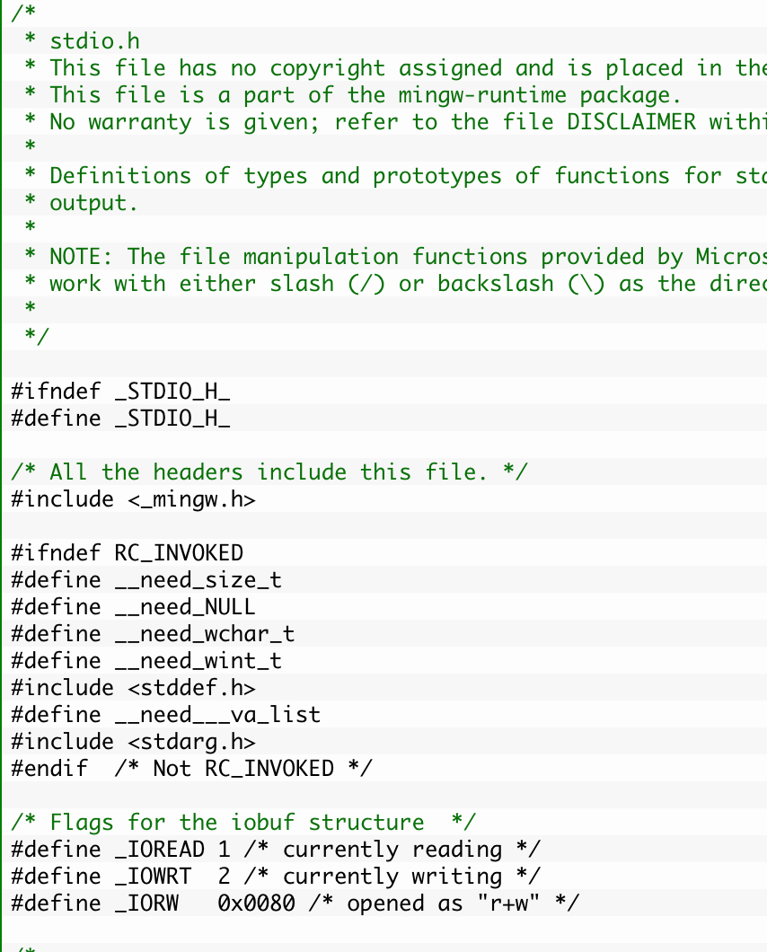
Let’s have a look at our old friend stdio.h.
This is FYI only. You do not need to memorize, or even think about, any of this functions details.
http://fresh2refresh.com/c-programming/c-function/stdio-h-library-functions/
...

Slide 69
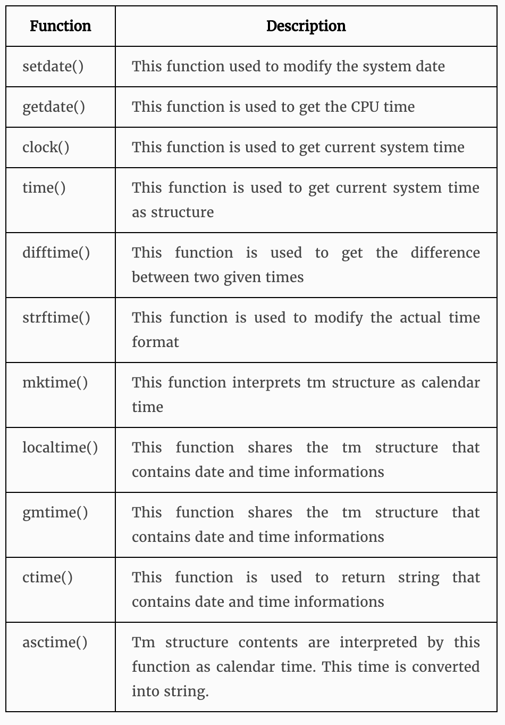
time.h
#include <stdio.h> #include <time.h> int main(void) { time_t start,end; volatile long unsigned counter; start = time(NULL); for(counter = 0; counter < 500000000; counter++) ; /* Do nothing, just loop */ end = time(NULL); printf("The loop used %f seconds.\n", difftime(end, start)); return 0; }

Slide 70
time.h
Use time.h and the functions in this slide, but implement them into one of our past programs… your favorite. Use this to time the execution length of:
If
For …
While…
Scanf …
Printf…
statements.
Then, share the results with your peers.
#include <stdio.h> #include <time.h> int main(void) { time_t start,end; volatile long unsigned counter; start = time(NULL); for(counter = 0; counter < 500000000; counter++) ; /* Do nothing, just loop */ end = time(NULL); printf("The loop used %f seconds.\n", difftime(end, start)); return 0; }

Slide 71
Thurs, 6/22/17
Afternoon videos
Pointers, https://youtu.be/Rxvv9krECNw
https://youtu.be/h-HBipu_1P0

Slide 72
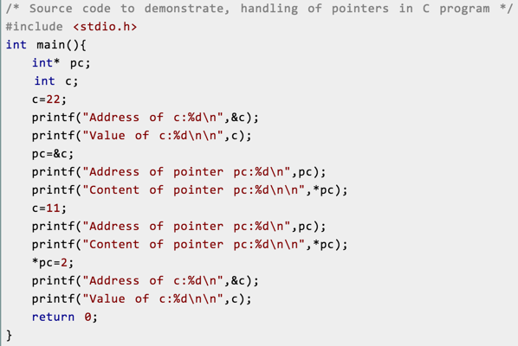
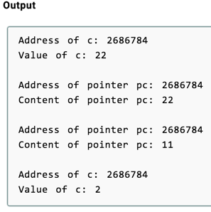
Pointers
Access the memory and manipulate the address.
http://www.programiz.com/c-programming/c-pointers
Compile pointers.c. Then run twice.
What do you notice?

Slide 73
Pointers
Access the memory and manipulate the address.
http://www.programiz.com/c-programming/c-pointers
Common mistakes:
int c, *pc; pc=c; /* pc is address whereas, c is not an address. */ *pc=&c; /* &c is address whereas, *pc is not an address. */

Slide 74
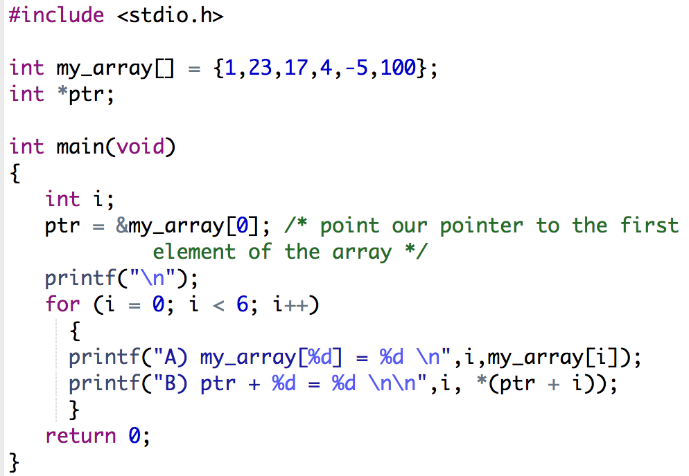
Exercise -- Pointers & Arrays
Run. Study what’s happening.

Slide 75
Exercise -- Pointers & Arrays
Then Change line B to read:
printf("ptr + %d = %d\n",i, *ptr++); and run it again.
Then change it to:
printf("ptr + %d = %d\n",i, *(++ptr)); and try once more.
Each time try and predict the outcome and carefully look at the actual outcome.
http://www.programiz.com/c-programming/c-pointers

Slide 76
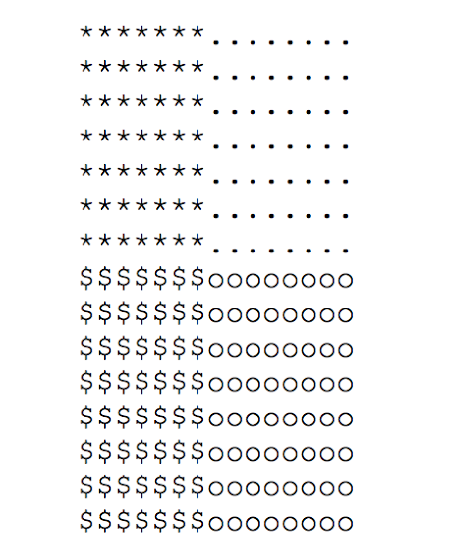
Write a main() program that prints an n by n square of characters. Divide the square into quarters, and fill each quarter with a different character. Here is the output when n==15:
For extra fun, make n and the characters for each quadrant command line parameters. (But the answer does not do this.)

Slide 77
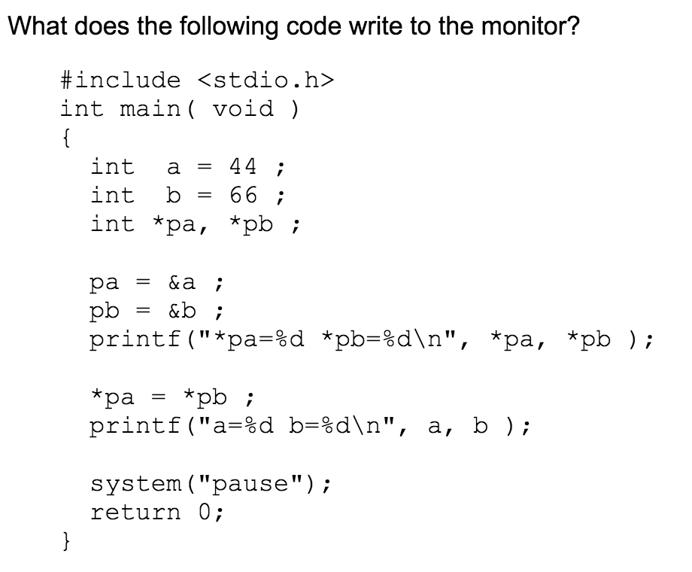

Slide 78


Slide 79

Then, fix the swap function.

Slide 80
Fri, 6/23/17
Morning videos
time.h, https://youtu.be/5TRC3R4dQNM
Time functions, https://youtu.be/4j0pRe8rxhs
Timing program, https://youtu.be/I-vw0aIZ4FI
Afternoon videos
Function calls, https://youtu.be/341VqGbPFk8
(continuation) https://youtu.be/gFngmTjSuHM
Function examples, https://youtu.be/_oyuKw3vBf8
Return values, https://youtu.be/ye2tvFir65g
Structures, https://youtu.be/VMFKz7Klx7I
-> op https://www.youtube.com/watch?v=2RP4f9beidc
struct and -> , https://youtu.be/J2iHTv5VVgg

Slide 81
time.h another example
Read this
#include <stdio.h> #include <time.h> #define PST (-8) #define CET (1) int main () { time_t raw_time; struct tm *ptr_ts; time ( &raw_time ); ptr_ts = gmtime ( &raw_time ); printf ("Time Los Angeles: %2d:%02d\n", ptr_ts->tm_hour+PST, ptr_ts->tm_min); printf ("Time Amsterdam: %2d:%02d\n", ptr_ts->tm_hour+CET, ptr_ts->tm_min); return 0; }

Slide 82
Write a program that calculates the time differences between Houston and:
NYC
LA
Juneau
London
Moscow
Tokyo
Ankara
Sydney
Wellington
B) Copy-past this problem. Then, use this information along with IF statements to print on the screen whether it is a good idea to call people in those cities over the phone, at noon Houston time (CT).

Slide 83

Control -- user defined functions
Help organize programs in sections with specific tasks.
Strong C capabilities: its flexibility to create very personalized user defined functions and data types.
Example:
userFunction.c
Type and run.
Do you understand
the control path?

Slide 84
Exercise -- Functions
stdDeviation.c received over email.
It’s a program that computes the standard deviation of dynamically read data. What’s new?
Run the program in codechef/code Blocks.
Then:
Create a function in this program. The idea is that the main() function only takes care of reading data, while the new function takes care of math.

Slide 85
Sorting arrays by selection. You will receive “SelectionSort.c” via email. Copy paste to your C programming console (codechef, visual studio, etc.). Read it and make sure you understand what it does.
Then, substitute ALL ??? by the correct code so that it works properly.
Note the use of functions and pointers.
Can you think of a different way of doing the same task? If so, then share your thoughts!

Slide 86
Sorting arrays by randomizing. You will receive “RandomSort.c” via email. Copy paste to your C programming console (codechef, visual studio, etc.). Read it and make sure you understand what it does.
Then, substitute ALL ??? by the correct code so that it works properly.
Note the use of functions, random numbers, #include variables and pointers.
Can you think of a different way of doing the same task? If so, then share your thoughts!

Slide 87

Read this material on how strings are dealt with, and the importance of their use in C.
https://chortle.ccsu.edu/CPuzzles/PartS/stringsIntro.html

Slide 88
Day 2.
*Math 1 https://youtu.be/vvpDbhqPrww?t=7m2s
*Math 2 https://youtu.be/_oqmPcqWHlE?list=PL6gx4Cwl9DGAKIXv8Yr6nhGJ9Vlcjyymq

Slide 89
Tests
url | taken? | Date taken
http://www.sanfoundry.com/online-c-test-increment-decrement-operators/ | No

